Slide 1
Introduction to MySQL
Ivan Yonkov
Training Lead
Software University
www.softuni.bg
Installation, Clients, Queries

Slide 2
PHP

Slide 3

DATABASE
Notes:
A database is an organized collection of data.^{[1]} It is the collection of schemas, tables, queries, reports, views, and other objects. The data are typically organized to model aspects of reality in a way that supports processes requiring information, such as modelling the availability of rooms in hotels in a way that supports finding a hotel with vacancies.
A database management system (DBMS) is a computer software application that interacts with the user, other applications, and the database itself to capture and analyze data.

Slide 4
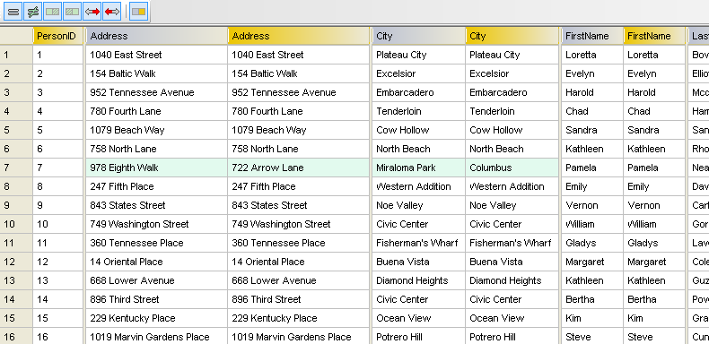
RELATIONAL DATABASE
Notes:
This model organizes data into one or more tables (or "relations") of columns and rows, with a unique key identifying each row. Rows are also called records or tuples.^{[2]} Generally, each table/relation represents one "entity type" (such as customer or product). The rows represent instances of that type of entity (such as "Lee" or "chair") and the columns representing values attributed to that instance (such as address or price).

Slide 5
Installation
1. MySQL Server: Official site or XAMPP
2. MySQL Client: HeidiSQL
Notes:
A relational database management system (RDBMS) is a database management system (DBMS) that is based on the relational model as invented by E. F. Codd, of IBM's San Jose Research Laboratory. In 2016, many of the databases in widespread use are based on the relational database model.
RDBMSs have been a common choice for the storage of information in new databases used for financial records, manufacturing and logistical information, personnel data, and other applications since the 1980s.
---
An RDBMS Client is the software that manages to usage of the RDBMS. For instance the connection to the database server and operations upon the db objects (such as creating databases, tables, and manipulating data).

Slide 6
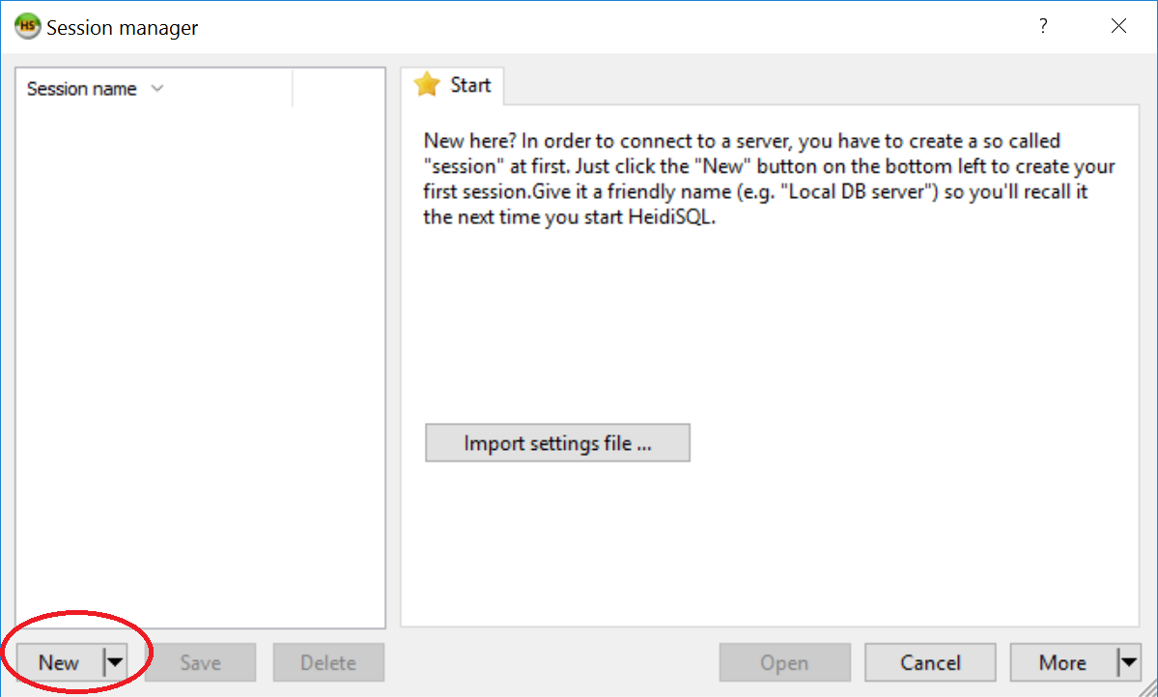
Connection

Slide 7
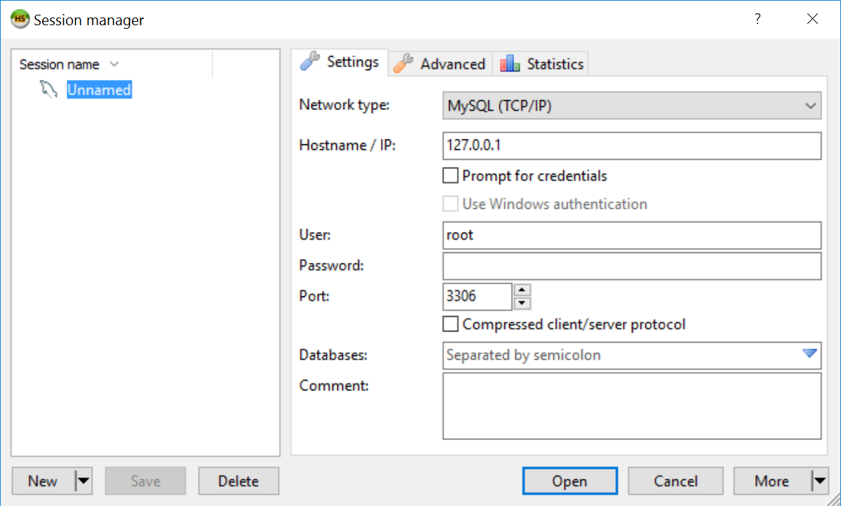
Connection (2)
DB User
DB Pass

Slide 8
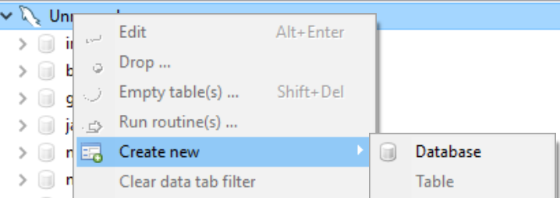
DB Creation

Slide 9
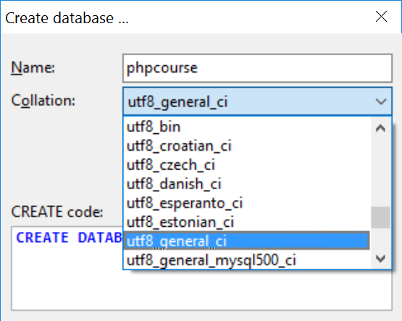
DB Creation (2)
Encoding
Notes:
The collation for DB is important about the data integrity. When it is on DB level, it’s inherited by the child objects (tables, columns).

Slide 10
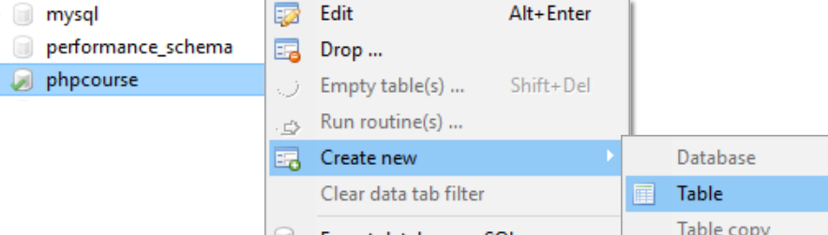
Table Creation

Slide 11
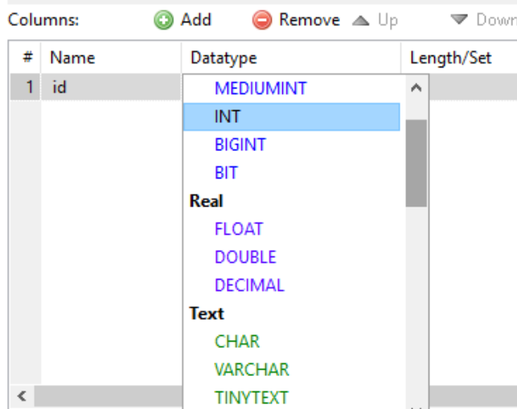
Table Creation – Data Types
Notes:
MySQL supports many of the standard datatypes, such as numeric, text, date and time and binary ones.

Slide 12
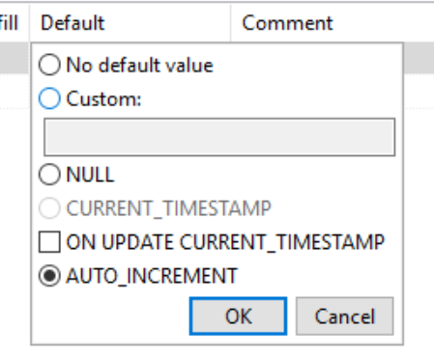
Table Creation – Autoincrement
Notes:
Autoincrement can be set on integer fields. This mean the column value will be auto-populated with the next integer when a row is inserted. It’s often used for primary keys

Slide 13
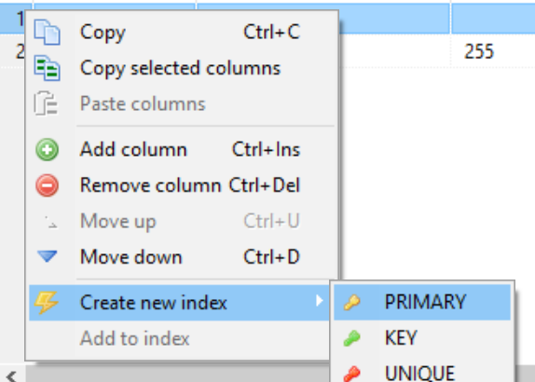
Table Creation – Autoincrement
Notes:
Autoincrement can be set on integer fields. This mean the column value will be auto-populated with the next integer when a row is inserted. It’s often used for primary keys

Slide 14
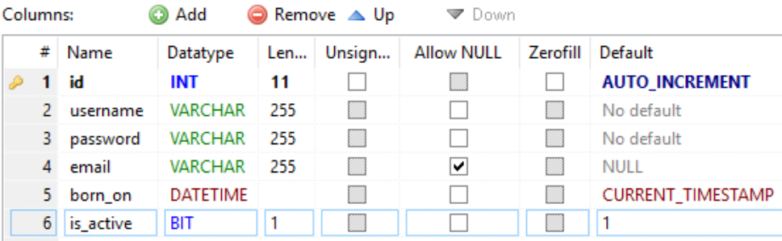
Table Creation – Example
Auto Increment
Primary Key
Optional
NOW() When No Value
True/False
Notes:
This is the “users” table. The definition implies that single user has an username, a password, maybe an email (optionally), date field denoting when one was born and whether it’s an active user or not.

Slide 15
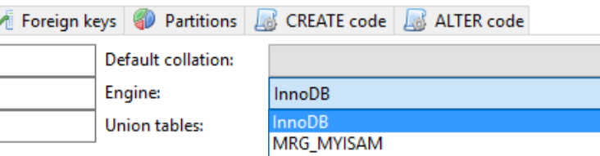
Table Creation – Example
DB Engine
Notes:
MySQL supports several database engines. InnoDB is the most recent one, supporting foreign keys. Use InnoDB ALWAYS.

Slide 16
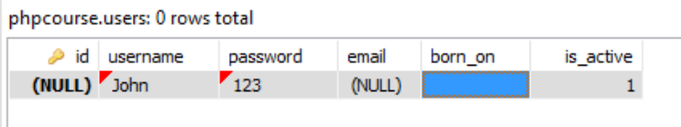
Table Population – Example
The empty columns will be auto-populated because of the default values

Slide 17
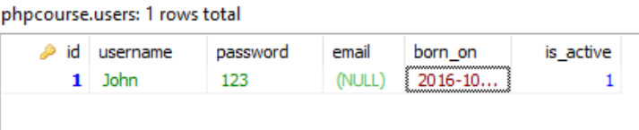
Table Population – Example

Slide 18
Table Population – Example
Notes:
Autogenerated from the GUI

Slide 19
Exercises
Notes:
Exercises for creating tables from the GUI (Section I from Exercises).

Slide 20
SQL Queries
Notes:
The most common operation in SQL, the query, makes use of the declarative SELECT statement. SELECT retrieves data from one or more tables, or expressions. Standard SELECT statements have no persistent effects on the database. Some non-standard implementations of SELECT can have persistent effects, such as the SELECT INTO syntax provided in some databases.^{[19]}
Queries allow the user to describe desired data, leaving the database management system (DBMS) to carry out planning, optimizing, and performing the physical operations necessary to produce that result as it chooses.
A query includes a list of columns to include in the final result, normally immediately following the SELECT keyword. An asterisk ("*") can be used to specify that the query should return all columns of the queried tables. SELECT is the most complex statement in SQ

Slide 21
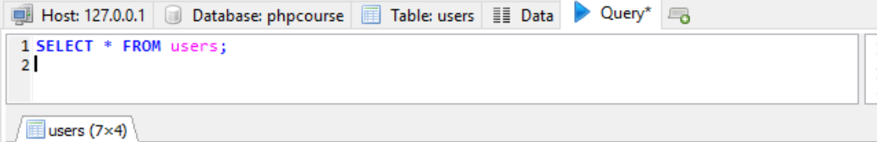
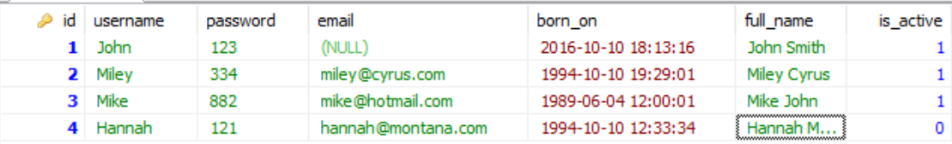
SELECT (everything)
Notes:
The * qualifier denotes to selected every column in the table in the order they were created.

Slide 22
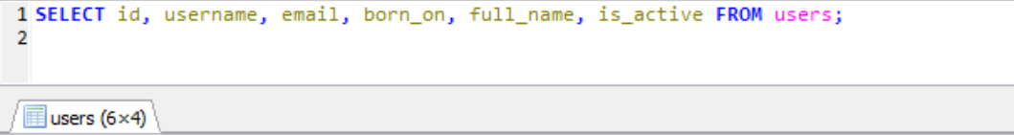
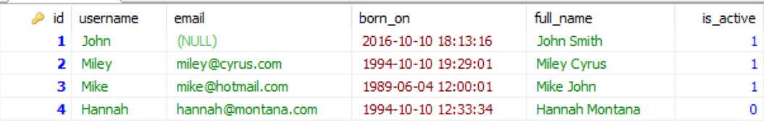
SELECT (projection)
Columns
Table
`password` column is missing
Notes:
A projection is the way to transform one data to another. In functional programming it’s called map(). The PHP’s equivalent is array_map. In C# they call it .Select()

Slide 23
SELECT (filtration)
Find all active users
Notes:
A filtration is the operation where the resultset is reduced to a certain condition. In functional programming they call it filter();
In PHP the equivalent is array_filter() and in C# it’s .Where();

Slide 24
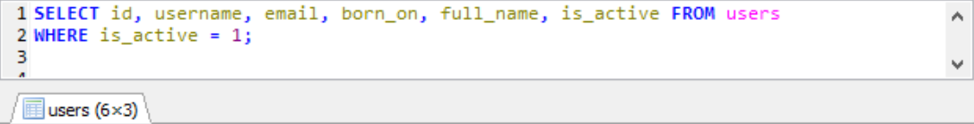
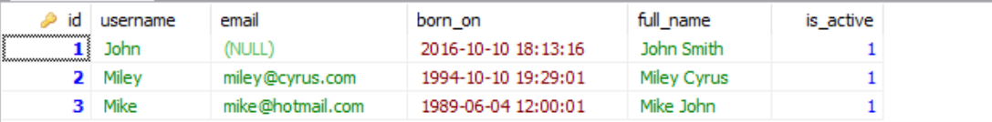
SELECT (filtration)
Condition

Slide 25
SELECT (filtration)
Find all active users, which username starts with ‘M’

Slide 26
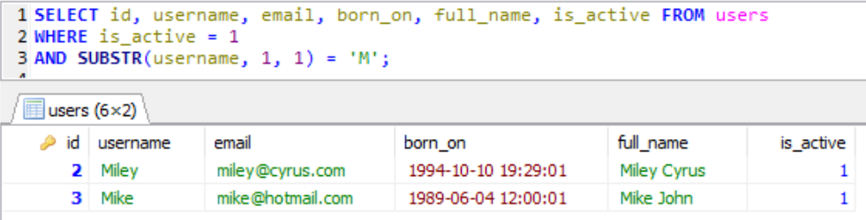
SELECT (filtration)
Notes:
There WHERE clause can accept logical operators in order to build a logical condition. You can use OR, AND, NOT or even IN.
The IN operator is used to search in another resultset – it may come from comma-separated values or another query.
SELECT * FROM users WHERE SUBSTR(username, 1, 1) IN (‘M’, ‘J’); will find users whose username starts either with ‘M’ or ‘J’.
SELECT * FROM users WHERE SUBSTR(username, 1, 1) IN (SELECT letter FROM alphabet); will find users whose username starts with any of the letters in an alphabet table (imaginary).

Slide 27
INSERT
Register an active user

Slide 28
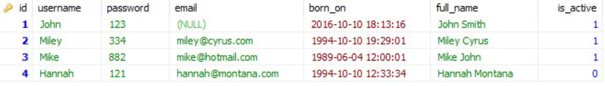
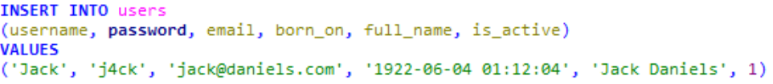
INSERT
Before
New Row

Slide 29
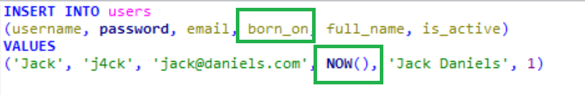
INSERT
Function Call
Notes:
The values can be results of function calls or subqueries e.g. in any column placeholder you can write a SELECT query whose result will be evaluated there.

Slide 30
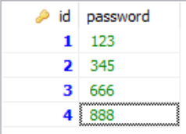
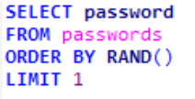
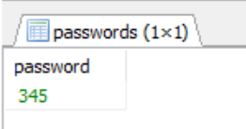
INSERT - Subquery
Random Row
Result set
`passwords` table
Notes:
INSERT with a query for a value

Slide 31
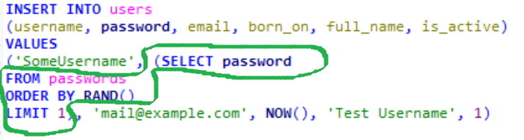
INSERT – Subquery (2)
Notes:
INSERT with a query for a value

Slide 32
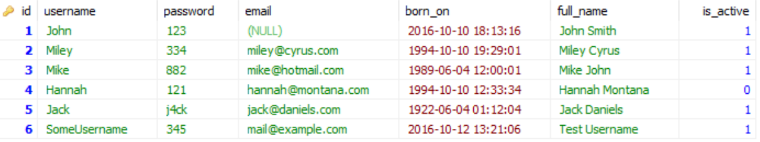
INSERT – Subquery (3)
Produced Another Random Password
Notes:
INSERT with a query for a value

Slide 33

UPDATE
Before
Update Query
After
Notes:
Update modifies existing rows’ one or more columns
The same rule applies for WHERE operator as in SELECT. Also the same rules from the INSERT regarding values from functions and subqueries

Slide 34
Exercises
Notes:
Exercises for data manipulating

Slide 35
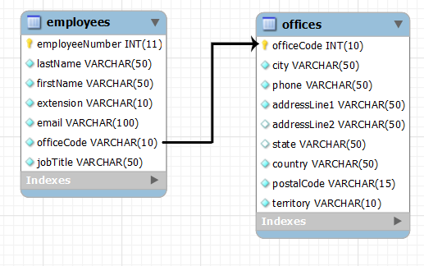
TABLE RELATIONS
Notes:
This model organizes data into one or more tables (or "relations") of columns and rows, with a unique key identifying each row. Rows are also called records or tuples.^{[2]} Generally, each table/relation represents one "entity type" (such as customer or product). The rows represent instances of that type of entity (such as "Lee" or "chair") and the columns representing values attributed to that instance (such as address or price).
https://technet.microsoft.com/en-us/library/ms190651(v=sql.105).aspx

Slide 36
Database Relationships
Each topic should belong to a single category
Notes:
Our forum so far consists for users, categories and topics. But the topics should belong to one of the existing categories.

Slide 37


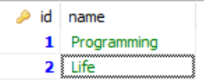
Database Relationships
Topic
Categories
Foreign key
Notes:
Adding `category_id` column (integer) which is so called foreign key, that references Categories table and its `id` column. The values in `category_id` should be in the set of `id` values in `categories`. No other values are allowed

Slide 38

Database Relationships (2)
Notes:
Creating the new column

Slide 39
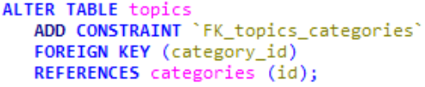
Database Relationships (3)
Foreign Key Name
Column Name
Referenced Table
Referenced Column
Notes:
Creating the Foreign Key constraint

Slide 40
DB Relations - Extraction
Extract the topic title and body along with the category name it belongs to

Slide 41
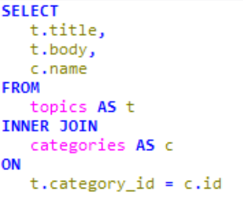
DB Relations – Extraction (2)
Using the Alias
Alias
Alias

Slide 42
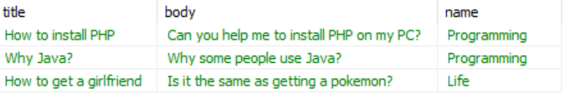
DB Relations – Extraction (3)
The Joined Resultset

Slide 43
Exercises
Notes:
Exercises for Relations

